Slide 1






AGRICULTURAL RAW MATERIAL ANALAYSIS _ ( WEATHER ANALYASIS FOR CROPS)
Student Details
Name: ABDULLA S
NM Id:au2021109310
College Name: College of engineering Guindy

Slide 2
WEATHER ANALYASIS FOR CROPS
Disclaimer
The content is curated from online/offline resources and used for educational purpose only

Slide 3

Course Outline
WEATHER ANALYASIS FOR CROPS
Abstract
Problem Statement
Aims, Objective & Proposed System/Solution
System Deployment Approach
Model Development & Algorithm
Future Scope
Video of the Project
Conclusion
Reference

Slide 4
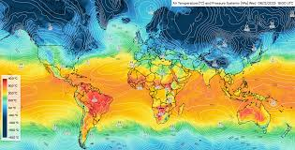
WEATHER ANALYASIS FOR CROPS
Abstract
Weather data visualization plays a critical role in understanding meteorological phenomena and informing decision-making across various sectors. This abstract examines the significance of enhancing weather data visualization techniques to empower users with clearer insights and facilitate effective responses to weather-related challenges. The abstract discusses the current landscape of weather data visualization, highlighting its strengths and limitations. It underscores the necessity of improving visualization methods to address complex weather patterns, climate change impacts, and emerging user needs.
.

Slide 5


WEATHER ANALYASIS FOR CROPS
Problem Statement
The need for specialized tools to create, analyze, and present meteorological data in the form of maps and charts. These tools are crucial for meteorologists, researchers, and the general public to understand complex weather patterns quickly and make informed decisions. Weather map software plays a vital role in forecasting, tracking severe weather events, and providing insights into atmospheric conditions. By offering clear visual representations of weather data, these tools contribute to public safety by enabling timely warnings, emergency responses, and proactive planning for various weather conditions

Slide 6

WEATHER ANALYASIS FOR CROPS
Aim and Objective
Aim: The primary objective of this Final Seminar is to present the outcomes and advancements made in the project “Weather data visualization ” “

Slide 7
WEATHER ANALYASIS FOR CROPS
Objectives
Temperature – You can use time series data to show the changing temperature throughout the day or provide a spread of the temp ranges on a given day. This can help contextualize hot or cold temperatures.
Precipitation – Show the chances of rain based on historical data on a day or on an hourly basis.
Snow – Assess the likelihood of snow, as well as how much may fall in a given time period.
Wind Speed – Help users understand the risk of severe windstorms using real-time radar and graphs.
Cloud Cover – Satellite imagery of the contiguous United States demonstrates the trends in cloud cover, which is especially helpful for would-be astronomists.
Humidity – Visualizing this dataset helps alert users to the potential of heat stroke when humidity levels reach a certain point.
Solar Energy – This is one of the most important data sources for energy companies, dynamic maps of solar energy help identify energy output for transmission lines.

Slide 8

WEATHER ANALYASIS FOR CROPS
Proposed Solution
SmartMet is a tool that allows forecasters to make updates to numerical weather model output based on meteorologist expertise and available observations. It ensures the best quality for edited data, weather forecasts, and products, making it an effective tool for improving or changing model data
Notes:
8

Slide 9
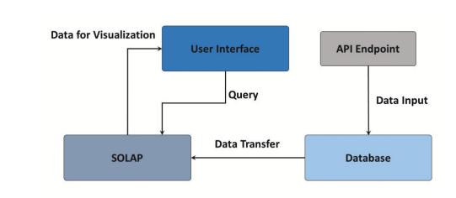
WEATHER ANALYASIS FOR CROPS
System Deployment Approach
Notes:
9

Slide 10
WEATHER ANALYASIS FOR CROPS
Model Development & Algorithm
Datasets. Observational datasets provide from various weather stations obtained with codes SYNOP (surface station reports observations). SYNOP reports are typically sent every three hours, which consists of groups of numbers describing general weather information, such as the temperature, sea level pressure, visibility,
wind direction and speed, etc. The numerical weather prediction models are initialized using NCEP (National Centers for Environmental Prediction) Global Forecast System analysis and forecasts at 0.5 deg horizontal resolution
Notes:
10

Slide 11
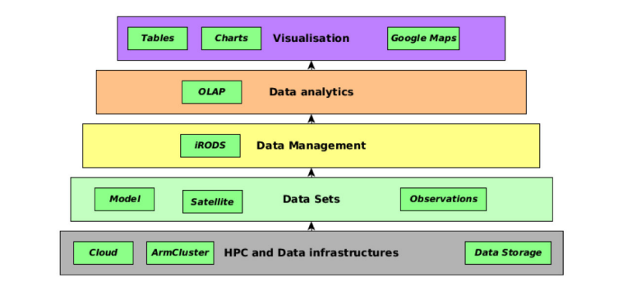
Model Development & Algorithm
Notes:
11

Slide 12
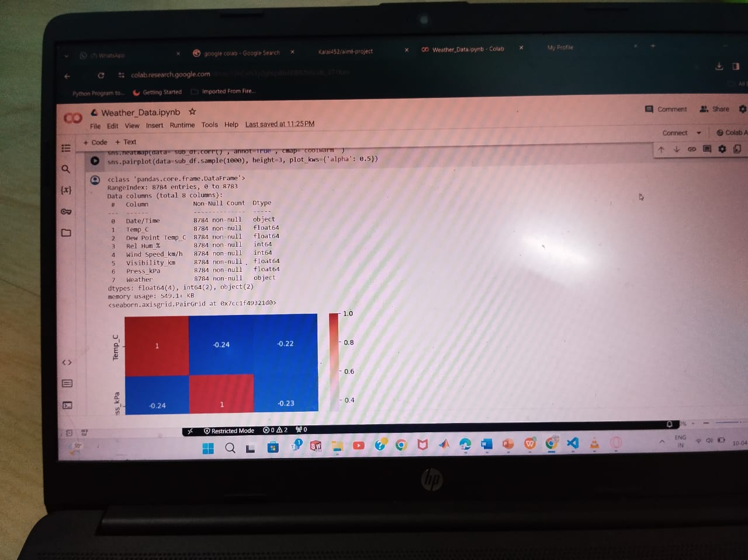
Result
Notes:
12

Slide 13

Future Scope
Real-time Visualization: As technology continues to advance, real-time visualization of weather data will become more sophisticated and accessible. This will enable users to monitor and respond to rapidly changing weather conditions with greater accuracy and efficiency, particularly in scenarios such as disaster management and emergency response.
Predictive Visualization: Integrating predictive modeling techniques with weather data visualization can provide forecasts with higher precision and longer lead times. This includes not only traditional weather forecasting but also predictive analytics for climate change impacts, enabling stakeholders to anticipate and adapt to future weather patterns and extreme events.
Notes:
13

Slide 14

Conclusion
. The suggested platform enables to integrate already available observational, model-fore cast and multispectral satellite images and use these data sources for studies and analyzes in a web-based
visualization environment. The interactive comparison charts for 2m air temperature allows to visually analyze and gather the information about model accuracy. It enables to adjust the forecasting results with additional methods by implementing statistical analyzes and provides a fairly high result in cases where the model’s sensitivity is low.
Notes:
14

Slide 15
Reference
https://www.researchgate.net/publication/325078800_Weather_Data_Visualization_and_Analytical_Platform
Notes:
Reference
These are the references for this session.

Slide 16
Thank you!
Notes:
16

